Slide 1
Towards a Theory Model for Product Search
Panos Ipeirotis
(with Anindya Ghose and Beibei Li)
Leonard N. Stern School of Business
New York University
Notes:
Towards a Theory Model for Product Search

Slide 2
How can I find the best hotel
in New York City?
Notes:
Often times in our lives, we are trying to find certain type of product. For example, if we are going to Long Beach for a vacation, we may want to find the best hotel in town with easy access to the highway and beach, and lots of nightlife, and more importantly, provides a great price for what it offers.

Slide 3
Recommender Systems?
Problem:
Low purchase frequency for many product types
Cold start for new consumers and new products
Privacy and data availability: Individual-level purchase history to derive personal preference.
Notes:
There are some tools that try to handle consumer heterogeneity and multi-preference, one example is…

Slide 4
Facet Search?
Problem:
- Likely to miss a deal;
- Still need to rank the results!
Notes:
Other tools like FS also tries to manage consumer heterogeneity and multi-dimensional preference by…
Moreover, even though we could adjust/vary the criteria to include all the possible results, she still needs to rank them and figure out which one is the best value.

Slide 5
Skyline?
Skyline: Identify the “Pareto optimal“ set of results.
Problem:
- Feasibility diminishes as # of product characteristics increases.
Notes:
With more than 5 or 6 characteristics, the probability of a point being classified as “Pareto optimal" dramatically increases. As a consequence, the set of Pareto optimal results soon includes every product.

Slide 6
IR-based approaches?
Problem:
Finding relevant documents is not the same as choosing a product
We can “consume” many relevant documents, but only seek a single product…
Perhaps IR theory should not be driving product search
Notes:
There are some tools that try to handle consumer heterogeneity and multi-preference, one example is…

Slide 7
Theoretical Background
How to define “Best Value”?
Economic Surplus: Quantify gains from exchanging goods.
How to measure “Surplus”?
Utility Theory: Measure the satisfaction from consumption of various goods and services.
How does “Utility” work?
Everything has its utility: e.g., products, money.
Buying a product involves the exchange of utilities in-between.
To measure “Utility”: Utility of Products, Utility of Money.
Notes:
Goal: Find product with best value.
Key: How to evaluate “best value” from buying a product?
The hedonic price model assumes that differentiated products are described by vectors of objectively measured characteristics. In addition, the utility that a consumer has for a product can be decomposed into an implicit value for each product characteristic.
Based on Marshall’s principal of economics, it is often assumed that marginal utility of money is approximately constant over small intervals.

Slide 8
Theoretical Background: Utility Theory
How to define “Best”?
>=?=<
Get Hotel
(happy)
Pay Money
(unhappy)
Utility: Quantify the happiness.
Utility of Product
Utility of Money
Notes:
Our final goal is to find the best value product. However, what do we mean by best value? How to define it?
We define “value” by how happy or satisfied we feel after doing something. For example, in the case of hotel purchase, when we get a nice fancy hotel room, we are happy; but we are not so happy that we need to pay money. So whether we should buy it or not, depending on how much happiness we gain and how much we lose at the same time.
And how do we quantify these two effects? We introduce an economic concept “utility” to quantify the level of happiness. Therefore, to make a purchase decision, we need two things:

Slide 9
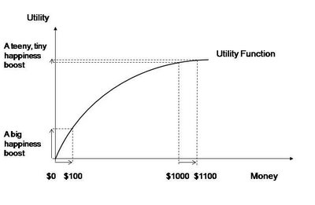
Utility of Money
Utility of Money – The utility that the consumer will lose by
paying the price for that product.
0 100
1M 1M+100
Characteristic Theory: Quantify gains from a purchase.
Notes:
Three features: 1. utility of money is increasing; 2. marginal utility of money is diminishing; 3. quasi-linear over small intervals

Slide 10
Utility of Product
Utility of Product : The utility that the consumer will gain from buying the product.
Simplest case: Use a linear combination:
Unobserved Product
Characteristics
Latent Consumer Preferences
Observed Product
Characteristics
Characteristic Theory: Quantify gains from a purchase.
Notes:
Basically, we assume that differentiated products are described by vectors of objectively measured characteristics. In addition, the utility of a product can be decomposed into a weighted sun of product characteristic.

Slide 11
Utility Surplus
Utility Surplus for a consumer is the gain in the utility of product minus the loss in the utility of money.
The higher the surplus, the higher “value” from a product
Rank high the products that generate high surplus!
Key Challenge: How to estimate the preferences?
Notes:
The weights here represent consumers’ preferences towards price and product characteristics.

Slide 12
From Utility Surplus to Market Shares and Back: Logit Model (McFadden 1974)
Utility is fundamentally private: We can never observe it!
But we can observe actions driven by utility!
Observed Market Share_j = Pr(Consumers choose j over everything else)
= Pr(Surplus_j > Surplus_everything else)
Assumption: Everyone has similar preferences, together with has a personal component of choice, the error term ε
Estimation Strategy: is proportional to the market share.
Notes:
The weights here represent consumers’ preferences towards price and product characteristics.

Slide 13
Logit Model - Estimation
Estimation Strategy: is proportional to the market share.
observed demand for j
observed total demand
Log of demand equals hotel utility! Estimate α,β parameters by regression
Solution by logistic regression!
Notice: Logistic Regression is a direct derivation from a theory-driven user behavior model, not a heuristic (McFadden, Nobel Prize in 2000)
Notes:
Market share is the percentage of total sales for a product in a market.
Note that logistic regression is not an adhoc choice, but is a direct derivation from a theory-driven user behavior model.
Daniel McFadden got the Nobel prize in Economics in 2000 for establishing the connection between logistic regression and
models of discrete user choice.
But consumers are different. For example, when looking for a hotel, young people like places with noisy nightlife (and willing to pay for that). Seniors pay more for areas away from the noise. Therefore, people’s preferences towards the same product characteristic (eg. downtown) are different.

Slide 14
But, consumers have different preferences

Slide 15
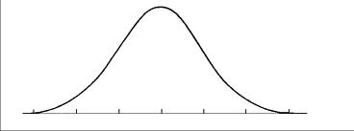
BLP Model (Berry, Levinsohn, and Pakes 1995)
Overall Preference
Overall
Preference
Type 1
Type 3
Type 2
BLP Model:
All consumers are not the same;
Consumers belong to groups with different preferences;
Group preference defined through consumer demographics, income, purchase purpose, …, etc.
T = [age, gender, income, purpose, …]
Preference = f (T)
Problem: We do NOT know T for individual consumers
Notes:
… So, if we know which group T the consumer belongs to, and meanwhile can observe what the consumer finally purchases, then we can infer the preference as a function of T very easily. However, the problem is, we do not observe individual-level purchase, in other words, our data is anonymous, and we do not know which group the consumer belongs to during the purchase. In this case, how can we infer the consumer’s preference?
For example, we do not know how many senior people or young people stay in Novotel, and we do not observe how may business travelers or honeymooners stay here either. We only know how many rooms sold in total. So, how to infer individual preference from aggregate-level demand?

Slide 16
BLP Model (Berry, Levinsohn, and Pakes 1995)
What do we know?
Demographic distributions!
Demographic differences in different markets!
Overall demand in different markets!
Basic Idea: Monitor demand for products in different markets.
differences in demand → different demographics
Notes:
Now let’s take a moment and try to think about what do we know? We do not know individual consumer’s demographics, but we do know the distribution of them. Moreover, we know the difference in the demographic distributions across different markets. What is more, we also observe different demand in different markets.
Because the same product will have the same demand from a given demographic group, any differences in demand across markets can be attributed to the different demographics.

Slide 17
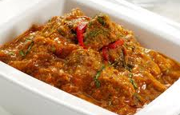
BLP Model - Example
Example 2: Lunch Buffet
Lamb: Stewed lamb with chillies;
Chicken: Flat pasta cooked with cream and cheese;
Table A: 80% Indians, 20% Americans;
- Lamb: 80% gone, Chicken: 20% gone.
Table B: 10% Indians, 90% Americans;
- Lamb: 10% gone, Chicken: 90% gone.
→ Indians favor lamb, and Americans favor chicken!
BLP: Aggregate Demand → Individual Preference
Notes:
…So, even though we did not directly observe what Indians eat, or what Americans eat, we can still derive their personal preferences just by looking at the aggregate-level demand change in different tables. And this is the major advantage of the BLP model we are using! For the time matter, I am not going to discuss in details how we estimate this model. All the details are provided in our paper.

Slide 18
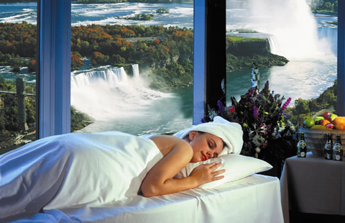
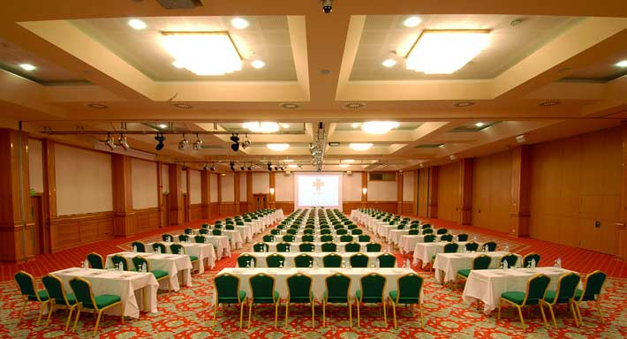
BLP Model – In Hotel Context
Example: Estimate preferences based on demographics
Hotels with spa and pool
Hotels with conference centers
Miami: 70% Couples, 30% Business;
- Spa: 80% demand, Conference: 20% demand.
New York: 30% Couples, 70% Business;
- Spa: 40% demand, Conference: 60% gone.
→ Couples favor spas, and business favor conference!
BLP: Aggregate Demand → Individual Preference
Notes:
…So, even though we did not directly observe what Indians eat, or what Americans eat, we can still derive their personal preferences just by looking at the aggregate-level demand change in different tables. And this is the major advantage of the BLP model we are using! For the time matter, I am not going to discuss in details how we estimate this model. All the details are provided in our paper.

Slide 19
Surplus-based Ranking
Basic Idea:
Compute the surplus for each product based on consumer preferences (average across consumers)
Rank products accordingly
Top-ranked product provides “best value”
Again, people are different…
Personalized Ranking: ask for consumer demographics and purchase context and estimate surplus using BLP for personalized ranking
Notes:
So as an economist, we are able to estimate the demand and infer the consumer preferences. We can say, ok we are done!
However, as a computer scientist, we want to ask ourselves, can we do better? Then we propose a surplus-based ranking system for products. The basic idea is……this gives us an idea of how much value consumers will get after buying each product, and the top-ranked……
Again, people are different. The best for you may not be the best for me. For example, I am a PhD student, when I am looking for a hotel at WWW, I look for the cheapest because price is the most important issue for me. I don’t care if it’s lousy, far away…→ cyber apartments is the best value for me! On the other hand, my advisor stays in the conference hotel, because he is much richer than me and less price sensitive. He cares more about the convenience and how comfortable the room is, while never mind if the price is 5 times higher or not.

Slide 20
Surplus-based Ranking
Example 3: Hotel Search at a conference
PhD Students
Lousy, Distant, Tiny,…
Cheapest!!!
Professors
Fancy, Convenient,
Comfortable,…
Costly
Best Value: Cyber Apartments
Best Value: Novotel
Notes:
So as an economist, we are able to estimate the demand and infer the consumer preferences. We can say, ok we are done!
However, as a computer scientist, we want to ask ourselves, can we do better? Then we propose a surplus-based ranking system for products. The basic idea is……this gives us an idea of how much value consumers will get after buying each product, and the top-ranked……
Again, people are different. The best for you may not be the best for me. For example, I am a PhD student, when I am looking for a hotel at WWW, I look for the cheapest because price is the most important issue for me. On the other hand, my advisor stays in the conference hotel, because he is much richer than me and less price sensitive. He cares more about the convenience and how comfortable the room is, while never mind if the price is 5 times higher or not.

Slide 21
Hotel Search Experiment - Data
Demand Data: Travelocity, 2117 hotels, 11/2008-1/2009.
Demographics: TripAdvisor, “Travel purpose,” “Age group” for travelers in different cities
Location Characteristics:
Social geo-tags
Geo-Mapping Search Tools
Image Classification
Service Characteristics: TripAdvisor & Travelocity
Stylistic Characteristics for the quality of word-of-mouth:
Text Mining: “Subjectivity,” “Readability”
Demand Data: Travelocity. Bookings for 2117 hotels, 2008/11-2009/1.
Consumer Demographics: TripAdvisor. Distribution of traveler types for each destination: e.g., “Travel purpose” and “Age group”

Slide 22
Result (1) - Economic Marginal Effects
Characteristics | Marginal Effect
Public transportation | 18.09%
Beach | 18.00%
Interstate highway | 7.99%
Downtown | 4.70%
Hotel class (Star rating) | 3.77%
External amenities | 0.08%
Internal amenities | 0.06%
Annual Crime Rate | - 0.27%
Lake/River | - 12.94%

Slide 23
Result (2) – Preference Deviations Based on Different Travel Purposes
Consumers with different travel purposes show different preferences towards the same set of hotel characteristics.

Slide 24
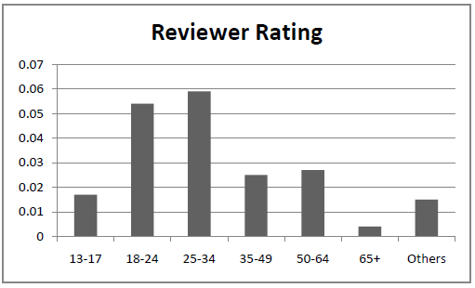
Result (2) - Sensitivity to Online Rating Based on Different Age Groups
Age 18-34 pay more attention to reviews than other age groups.

Slide 25
Ranking Evaluation - User Study (1)
Experiment 1: Blind pair-wise, 200 MTurk users, 6 cities, 10 baselines.
Finding: Our surplus-based ranking is overwhelmingly preferred in any single comparison! (p=0.05, sign test, in all comparisons)
User Explanations: Diversity; Price not the only factor;
Multi-dimensional preferences.
Our reasoning: Our economic-based model introduces
“diversity” naturally.
Notes:
Based on qualitative opinions of users, “diversity” is indeed an important factor that improves the satisfaction of consumers. Our economic-based ranking approach seems to introduce “diversity” more naturally.

Slide 26
Ranking Evaluation - User Study (1)
Notes:
…
We want to estimate the robustness of this user evaluation result.
This indicates the strong preference for hotels with the “best value”, but meanwhile it highlighted the need for a truly blind test, in order to eliminate the influence of titles.
Based on qualitative opinions of users, “diversity” is indeed an important factor that improves the satisfaction of consumers. Our economic-based ranking approach seems to introduce “diversity” more naturally.

Slide 27
Ranking Evaluation - User Study (2)
Experiment 2: Blind pair-wise, 200 MTurk users.
In all cases, the personalized approach is preferred
Notes:
This suggests that by incorporating consumers demographics and purchase context information, we can improve our surplus-based ranking even further.

Slide 28
Model Comparisons: Better Utility Models, Better Ranking
Economic Models of Discrete Choice:
Logit (McFadden 1974), BLP (1995), PCM (2007), Hybrid (2011)
Predictive Power:
Out-of-Sample prediction, training set size 5669, test set size 2430.
 | Extended Model with Demographics | Hybrid Model | BLP | PCM | Nested Logit | OLS
RMSE | 0.0347 | 0.0881 | 0.1011 | 0.1909 | 0.2399 | 0.3215
MSE | 0.0012 | 0.0078 | 0.0102 | 0.0364 | 0.0576 | 0.1034
MAD | 0.0100 | 0.0276 | 0.0362 | 0.0524 | 0.1311 | 0.2673
Notes:
Both in-sample and out-of-sample.
Our results illustrate our model outperforms the alternatives in predictive power. Our model provides best overall performance in both precision and deviation.

Slide 29
Model Comparisons: Better Utility Models, Better Ranking
Economic Models of Discrete Choice:
Logit (McFadden 1974), BLP (1995), PCM (2007), Hybrid (2011)
Ranking Performance:
Hybrid City | BLP | PCM | Nested Logit | Logit
New York | 68% | 64% | 61% | 67%
Los Angeles | 70% | 71% | 67% | 73%
SFO | 68% | 73% | 78% | 74%
Orlando | 72% | 65% | 76% | 70%
New Orleans | 70% | 66% | 68% | 69%
Salt Lake City | 64% | 69% | 62% | 65%
Significance Level | P=0.05 ≥ 59% | P=0.01 ≥ 62% | P=0.001 ≥ 66% | (Sign Test, N=100)
We observed that better utility models improve ranking
Notes:
Note: Percentages are not transitive!! No comparison among BLP, PCM, Nested Logit, OLS!

Slide 30
Hotel Search Engine Experiments
Notes:
So how does the new ranking system work? Moreover, what exactly is the impact of product search engine design on consumer behavior? To find this out, I conducted a set of randomized experiments on a real world hotel search engine designed in house.

Slide 31
Impact of Search Engine Design on Consumer Behavior
Research Question
What is the impact of different ranking mechanisms on consumer online behavior?

Slide 32
Impact of Search Engine Design on Consumer Behavior
Randomized Experiments
890 unique user responses, two-week period
Hotel search engine designed using Google App Engine
Online behavior tracking system
Subjects recruited online via AMT
Prescreening spammers (95% approval, <1 min)
Notes:
It builds on a hotel search artifact designed in house using…
It also includes a design of online consumer behavior tracking system.

Slide 33
Impact of Search Engine Design on Consumer Behavior
Randomized Experiments
Hotel Search Engine Application (http://nyuhotels.appspot.com)
Search
Context
Ranking
Methods
Notes:
…moreover, it provides the value for money computed for each hotel.
Consumers are able to conduct a hotel search using a set of randomly assigned search criteria, such as… They are also able to choose different ranking methods, such as…

Slide 34
Impact of Search Engine Design on Consumer Behavior
Notes:
For space limitation, I only show the top part of the page. It shows the overall value-for-money score, and the break down value score for each hotel characteristic, for example, downtown, it has a population-level average value score and a personalized value score for that consumer, based on her search criteria. Consumers can adjust the weight of preference for each feature, and can also change the search criteria on this hotel landing page.
Once consumer decide the make a purchase, she can click “buy-with-1-click.” If she decides to continue searching, can click the “back” button on the top and return to the previous search page.

Slide 35
Impact of Search Engine Design on Consumer Behavior
Randomized Experiments
Hotel Search Engine Application (http://nyuhotels.appspot.com)
Ranking Experiment Design (Mixed):
 |  | (Within-Subject)
 |  | New York City | Los Angeles
(Between- Subject) | Treatment Group 1 | BVR | BVR
 | Treatment Group 2 | Price | Price
 | Treatment Group 3 | Travelocity User Rating | Travelocity User Rating
 | Treatment Group 4 | TripAdvisor User Rating | TripAdvisor User Rating
Notes:
Consumer search, click, purchase behavior on the hotel search engine will be fully tracked.
For the first experiment, our goal is to examine the impact from 4 different ranking methods, BVR, Price, TL, TA on consumer behavior. I used a mixed design, where for between-subject design, each subject is randomly assigned to only one of the 4 treatment groups, …

Slide 36
Main Results – Ranking Experiment
Surplus-based ranking outperforms the other three in motivating online engagement and purchase.
 | Purchase Propensity (NYC) | Purchase Propensity (LA)
BVR | 0.80 | 0.92
Price | 0.62 | 0.75
Travelocity | 0.55 | 0.43
TripAdvisor | 0.61 | 0.57
Group mean over subjects. Significant (p<0.05), Post Hoc ANOVA.
Notes:
Robustness test: 95% users did not change sorting methods!!! –default ranking important!
Moreover, results still hold even after excluding users who have changed the sorting methods.

Slide 37
Robustness Tests
Users may change ranking and purchase under others.
- < 5% users changed ranking methods; hold after excluding those users.
Users with “planned purchases” favor “value” more.
- Allow users to leave without purchase.
Users didn’t buy from the top ranked, but lower ranked.
- BVR leads to significantly higher # purchases on top-3 positions, compared to the other ranking methods.
Users in BVR group are more likely to convert?
- Randomized assignment;
- Ask users about their online hotel shopping behavior (how often do
they search/purchase, price range, etc.), no significant difference.
Notes:
Confirmation bias: a tendency for people to favor information that confirms their preconceptions or hypothesis regardless of whether the information is true.
Users with “planned purchases” are serious buyers, and they are more likely to examine carefully and focus on the value of product, hence favor “value”-based ranking.

Slide 38
Conclusion & Future Work
A New Ranking System for Product Search
Economic utility theory, “Best Value” ranked on Top;
Validated with user study with +15000 users, 6 cities.
Major Contributions:
Inter-disciplinary approach
Captures consumer decision making process
Privacy-preserving: Aggregate data → Personal preferences
Future Directions:
Product bundles
Integrate search into choice model
Using consumer browsing info
Integrated utility maximization model
Notes:
We propose a new ranking systems for product search based on economic utility theory… where we rank the products by their economic surplus, which represents the best value for a consumer after purchase.
“causal” in the sense that this model can predict what “should” happen when we observe changes in the market,…for example, we see a new product entering the market, we can rank it by simply observing its characteristics, without waiting to see consumers’ demand for that product. Also, we can dynamically change the ranking in reaction to changes in products, i.e., price change.

Slide 39
Q & A
Demo: http://nyuhotels.appspot.com/
Thank you!

Slide 40
BLP Model (Berry, Levinsohn, and Pakes 1995)
Assumption: Consumers have heterogeneous preferences ( ) towards price and product characteristics.
Assumption 2: Consumer-specific preferences are a function of consumer demographics and purchase context.
Consumer Type
(e.g., purchase context, age group)
Consumer Income
Overall population preference = mixture of preferences from different types of consumers (or consumer segments) in the population.
Observed overall demand
→ Individual preference?
Overall Preference
Type 1
Type 3
Type 2
Notes:
Assumption 2: Consumer preferences are a function of consumer demographics and purchase context. For example, honeymooners prefer hotels with a romantic remote setting, while business travelers prefer accessibility to public transportation.
… If we observe the demand (i.e., purchase behavior) from each consumer (or segment) separately, we can infer individual preference simply using Logit. However, in real life, because we do not observe individual-level purchase, we only observe overall demand (market share). For example, we do not know how many senior people or young people stay in Novotel, and we do not observe how may business travelers or honeymooners stay here either. We only know how many rooms sold in total. So, how to infer individual preference from aggregate-level demand?

Slide 41
BLP Model - Estimation
Estimation Strategy:
Consumer Type
(e.g., purchase context, age group)
Consumer Income
Notes:
Keep this basic idea in mind, here is how we derive the weights. We assume the consumer-specific weights alpha and beta to be a function of consumer type T, and income I. Moreover, we assume them to follow certain distribution, with a mean and a standard deviation.

Slide 42
BLP Model - Estimation
Goal: and
Key: = observed market share → non-linear equation system.
Method: Iterative method to solve nested non-linear optimization.
Algorithm:
(Step 1) Initialize all parameters ;
(Step 2) Compute given ;
(Step 3) Estimate most likely given observed market share and ;
(Step 4) Find best to minimize remaining error in , evaluate GMM;
(Step 5) Use Nelder-Mead Simplex algorithm to update , and go to step 2, until minimizing GMM objective function.
Notes:
According to the BLP model, given the above utility function, the market share can be computed as the following, where P* is the population distribution function.

Slide 43
Result (1) - Mean Weights for Hotel Characteristics
Positive Impact
Beach
Interstate Highway
Downtown
Public Transportation
Hotel Class
Hotel External Amenities
Hotel Internal Amenities
Negative Impact
Price
Annual crime rate
Number of competitors
Lake
Spelling errors
Syllables
Complexity
Subjectivity
“Walkable beachfront!”
“Next to a highway”

Slide 44
Model Captures Consumers’ Real Motivation
Reasoning: Capture consumers’ specific expectations, dovetail with their real purchase motivation.
e.g., In the user study, business travelers indicated that they prefer quiet inner environment and easy access to highway or public transportation. This was fully captured in our estimation results, see (b).

Slide 45
Causal Model
A nice “side-effect” of building on economic theory is that such user behavior-based model cares mainly about causal effect – what should happen in future?
A new product enters the market;
Open a new restaurant for dinning;
A renovation on the swimming pool;
…
Notes:
Predict what should happen in future,…and rank products by simply observing the characteristics of the product, without waiting to see consumers’ actual demand to the new changes.

Slide 46
Agenda
Theoretical Background
Logit Model (i.e., Homogeneous Consumers)
BLP Model (i.e., Heterogeneous Consumers)
Ranking
Hotel Search Experiment
Conclusion and Future Work

