Slide 1
Quizz: Targeted Crowdsourcing with a Billion (Potential) Users
Panos Ipeirotis, Stern School of Business, New York University
Evgeniy Gabrilovich, Google
Work done while on sabbatical at Google

Slide 2
The sabbatical mission…
“We have a billion users… leverage their knowledge …”

Slide 3
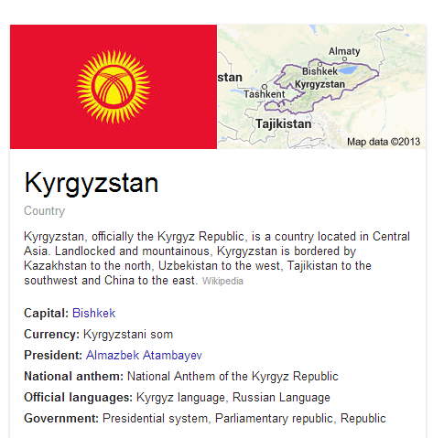
Knowledge Graph: Things not Strings

Slide 4
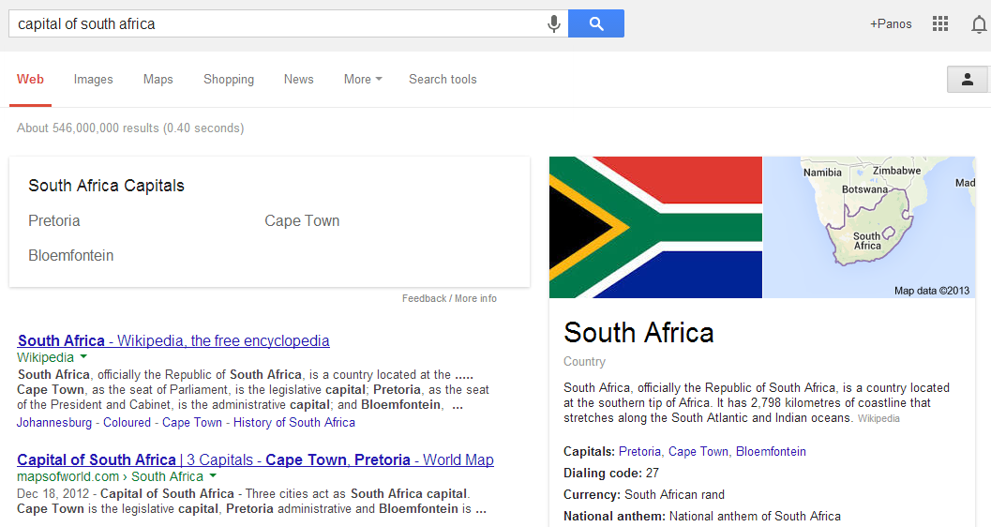
Knowledge Graph: Things not Strings

Slide 5
Still incomplete…
“Date of birth of Bayes” (…uncertain…)
“Symptom of strep throat”
“Side effects of treximet”
“Who is Cristiano Ronaldo dating”
“When is Jay Z playing in New York”
“What is the customer service number for Google”
…

Slide 6
The sabbatical mission…
“We have a billion users… leverage their knowledge …”
“Let’s create a new crowdsourcing system…”

Slide 7
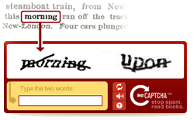
Ideally…

Slide 8
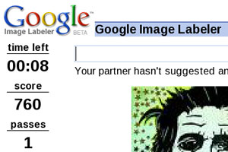
But often…

Slide 9
The common solution…

Slide 10
Volunteers vs. hired workers
Hired workers provide predictability
…but have a monetary cost
…are motivated by money (spam, misrepresent qualifications…)
…extrinsic rewards crowd-out intrinsic motivation
…do not always have the knowledge
Volunteers cost less (…)
…but difficult to predict success

Slide 11
Key Challenge
“Crowdsource in a predictable manner, with knowledgeable users, without introducing monetary rewards”

Slide 12
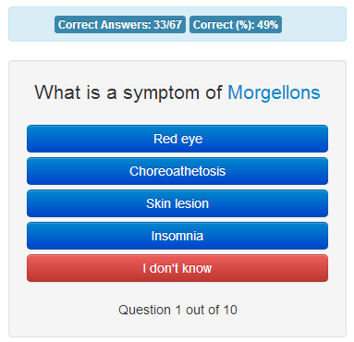
Quizz

Slide 13
Calibration vs. Collection
Calibration questions (known answer): Evaluating user competence on topic at hand
Collection questions (unknown answer): Asking questions for things we do not know
Trust more answers coming from competent users
Tradeoff
Learn more about user quality vs. getting answers (technical solution: use a Markov Decision Process)

Slide 14
Model: Markov Decision Process
a correct b incorrect
c collection
V = c*IG[a,b]
User drops out
User continues
Explore
Exploit
User correct
User incorrect
[a,b,c+1] V = (c+1)*IG[a,b]
[a+1,b,c] V = c*IG[a+1,b]
[a,b+1,c]
V = c*IG[a,b+1]

Slide 15
Challenges
Why would anyone come and play this game?
Why would knowledgeable users come?
Wouldn’t it be simpler to just pay?

Slide 16
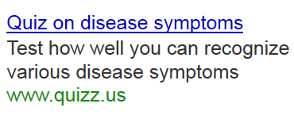
Attracting Visitors: Ad Campaigns

Slide 17
Running Ad Campaigns: Objectives
We want to attract good users, not just clicks
We do not want to think hard about keyword selection, appropriate ad text, etc.
We want automation across thousands of topics (from treatment side effects to celebrity dating)

Slide 18
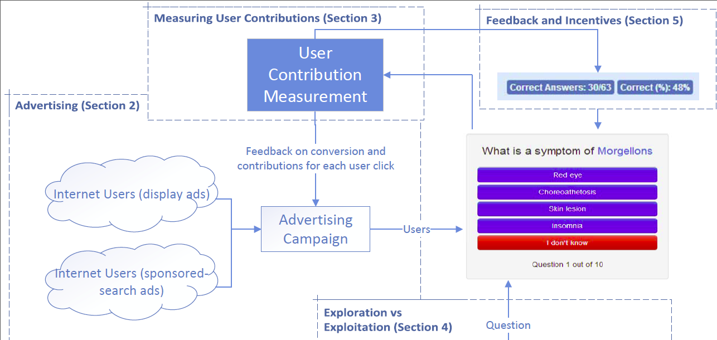
Solution: Treat Quizz as eCommerce Site

Slide 19
Solution: Treat Quizz as eCommerce Site
Feedback: Value of click

Slide 20
User Value: Information Gain
Value of user: total information contributed
Information gain is additive: #questions x infogain
Information gain for question with n choices, user quality q
Random user quality: q=1/n  IG(q,n) = 0
Perfect user quality: q=1  IG(q,n) = log(n)
Using a Bayesian version to accommodate for uncertainty about q

Slide 21
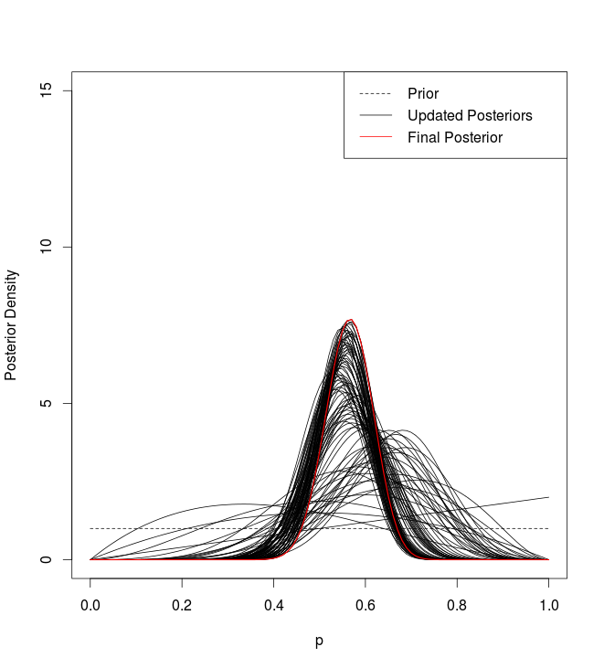
How to measure quality?
Naïve (and unstable) approach: q = correct/total
Bayesian approach: q is latent, with uniform prior
Then q follows Beta(a,b) distr (a: correct, b:incorrect)

Slide 22
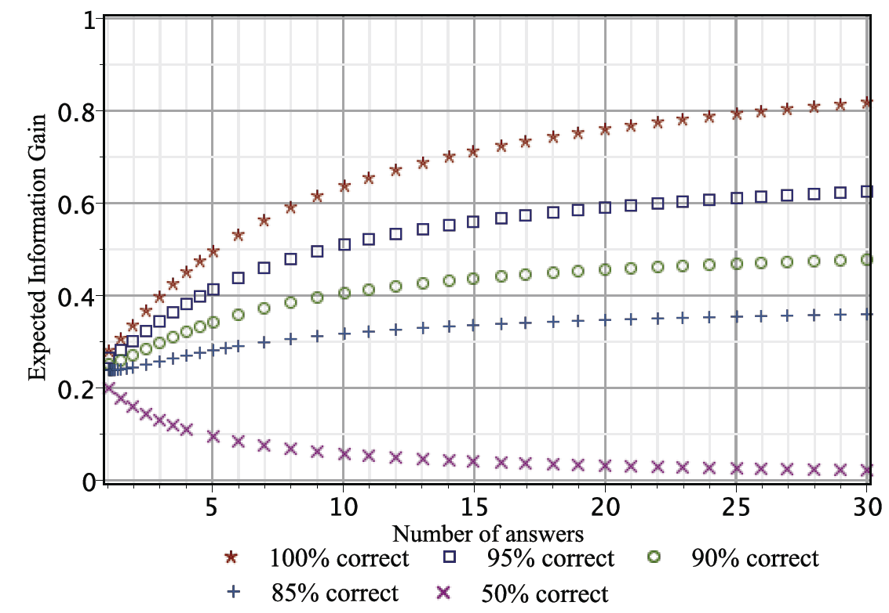
Expected Information Gain

Slide 23
Effect of Ad Targeting (Perhaps it is just more users?)
Control: Ad campaign with no feedback, all keywords across quizzes [optimizes for clicks]
Treatment: Ad campaign with feedback enabled [optimizes for conversions]
Clicks/visitors: Same
Conversion rate: 34% vs 13% (~3x more users participated)
Number of answers: 2866 vs 279 (~10x more answers submitted)
Total Information Gain: 7560 bits vs 610 bits (~11.5x more bits)

Slide 24
Effect of Optimizing for Conversion Value
Control: Feedback on “conversion event” but no value
Treatment: Feedback provides information gain per click
Clicks/visitors: Same
Conversion rate: 39% vs 30% (~30% more users participated)
Number of answers: 1683 vs 1183 (~42% more answers submitted)
Total Information Gain: 4690 bits vs 2870 bits (~63% more bits)

Slide 25
Example of Targeting: Medical Quizzes
Our initial goal was to use medical topics as a evidence that some topics are not crowdsourcable
Our hypothesis failed: They were the best performing quizzes…
Users coming from sites such as Mayo Clinic, WebMD, … (i.e., “pronsumers”, not professionals)

Slide 26
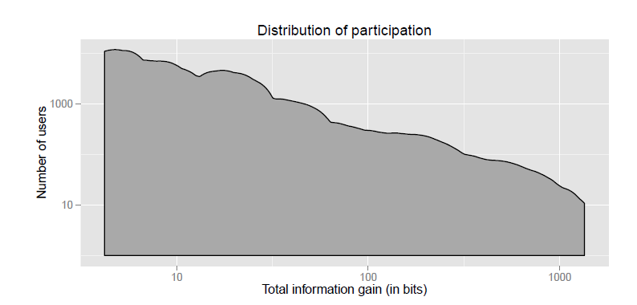
Participation is important!
Really useful users

Slide 27
Treatment | Effect
Show if user answer correct | +2.4%
Show the correct answer | +20.4%
Score: % of correct answers | +2.3%
Score: # of correct answers | -2.2%
Score: Information gain | +4.0%
Show statistics for performance of other users | +9.8%
Leaderboard based on percent correct | -4.8%
Leaderboard based on total correct answers | -1.5%
Immediate feedback helps most
Knowing the correct answer 10x more important than knowing whether given answer was correct
Conjecture: Users also want to learn

Slide 28
Treatment | Effect
Show if user answer correct | +2.4%
Show the correct answer | +20.4%
Score: % of correct answers | +2.3%
Score: # of correct answers | -2.2%
Score: Information gain | +4.0%
Show statistics for performance of other users | +9.8%
Leaderboard based on percent correct | -4.8%
Leaderboard based on total correct answers | -1.5%
Showing score is moderately helpful
Be careful what you incentivize though ☺
“Total Correct” incentivizes quantity, not quality

Slide 29
Treatment | Effect
Show if user answer correct | +2.4%
Show the correct answer | +20.4%
Score: % of correct answers | +2.3%
Score: # of correct answers | -2.2%
Score: Information gain | +4.0%
Show statistics for performance of other users | +9.8%
Leaderboard based on percent correct | -4.8%
Leaderboard based on total correct answers | -1.5%
Competitiveness (how other users performed) helps significantly

Slide 30
Treatment | Effect
Show if user answer correct | +2.4%
Show the correct answer | +20.4%
Score: % of correct answers | +2.3%
Score: # of correct answers | -2.2%
Score: Information gain | +4.0%
Show statistics for performance of other users | +9.8%
Leaderboard based on percent correct | -4.8%
Leaderboard based on total correct answers | -1.5%
Leaderboards are tricky!
Initially, strong positive effect
Over time, effect became strongly negative
All-time leaderboards considered harmful

Slide 31
Cost/Benefit Analysis

Slide 32
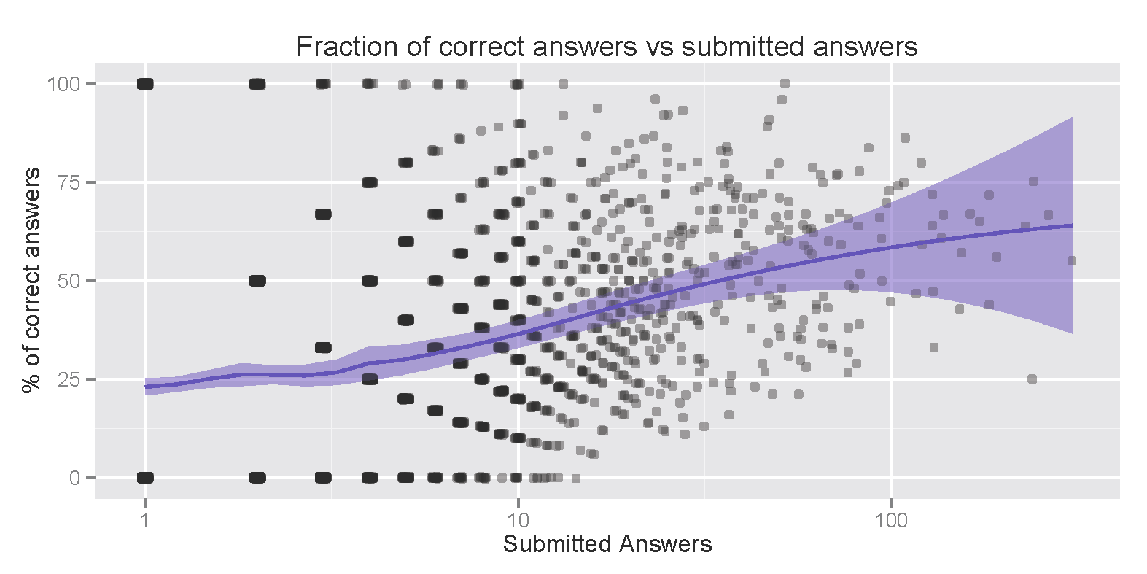
Self-selection and participation
% correct
Submitted answers
Low performing users naturally drop out
With paid users, monetary incentives keep them

Slide 33
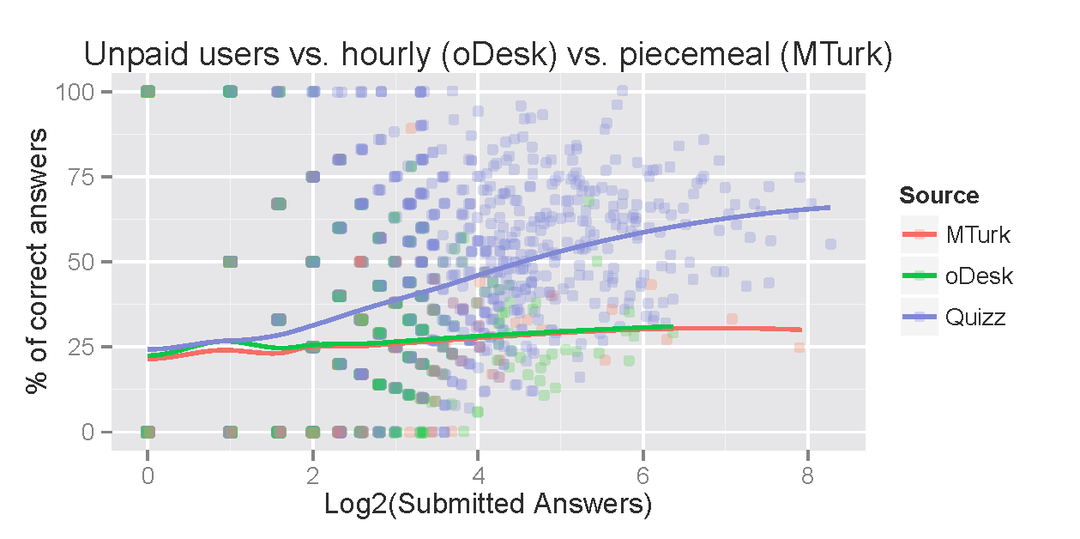
Comparison with paid crowdsourcing
% correct
Submitted answers
Best paid user
68% quality, 40 answers (~1.5 minutes per question)
Quality-equivalency: 13 answers @ 99% accuracy, 23 answers @ 90% accuracy
5 cents/question, or $3/hr to match advertising cost of unpaid users
Knowledgeable users are much faster and more efficient

Slide 34
Citizen Science Applications
Google gives $10K/month to nonprofits in ad budget
Climate CoLab experiment running
Doubled traffic with only $20/day
Targets political activist groups (not only climate)
Additional experiments: Crowdcrafting, ebird, Weendy

Slide 35
Conclusions
New way to run crowdsourcing, targeting with ads
Engages unpaid users, avoids problems with extrinsic rewards
Provides access to expert users, not available labor platforms
Experts not always professionals (e.g., Mayo Clinic users)
Nonprofits can use Google Ad Grants to attract (for free) participants to citizen science projects

